Slide 1
A Cognitive Meta-theory that integrates TESOL and Christianity
Lorin Friesen & Angelina Van Dyke
CELT Portland 2014
Multnomah University, Portland
March 2014

Slide 2
A Meta-Cognitive Functional Analogical Approach
Meta: Integrate other theories
  This can bring theoretical unity to TESOL.
Cognitive: Interacting cognitive modules
  Modules correspond to brain regions.
Functional: Cognitive mechanisms
  How does/can the mind function?
Analogical: Look for common patterns
  How research, teaching, identity, and culture interact
Mental Symmetry Model: Analyze many fields
  Each field provides corroborative evidence.

Slide 3
This session will present a…
We Apologize!
Paradigm Shifts are Messy
DOUBLE
PARADIGM
SHIFT
But anything less will be overcome
by the steamroller of entrenched scientism.

Slide 4
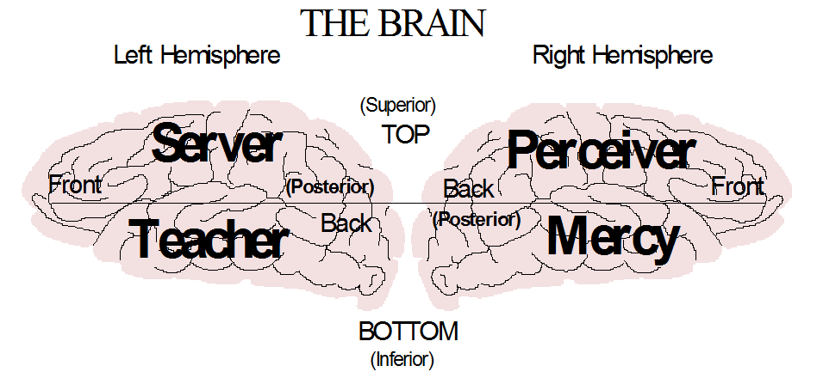
Mercy: Remembers emotional experiences; forms personal identity.
Teacher: Remembers words; builds general theories
  Data: temporal; processor: amygdala; internal structure: ventral frontal
Perceiver: Looks for repeated connections; facts, objects, and maps
Server: Looks for repeated sequences; performs actions.
  Data: parietal; processor: hippocampus; internal structure: dorsolateral frontal

Slide 5
Cognitive Styles vs. Modules
Cognitive Styles
  Each name describes a type of person
  The traits came from observing people
Cognitive Modules
  Each name describes a part of the mind
  Every person has all seven modules
  Each cognitive style ‘lives’ in a module
Cognitive Development
  The goal is to become mentally whole

Slide 6
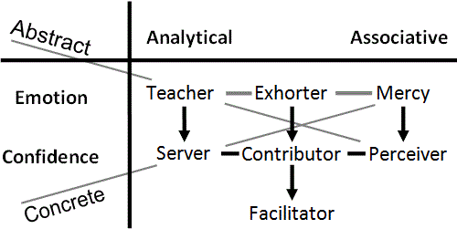
Two ways of processing
  Analytical (Time), Associative (Space)
Two ways of labeling information
  Emotion, Confidence (certainty)
Two mental circuits
  Abstract, Concrete
Two kinds of modules
  Simple (T S M P), Composite (E C F)

Slide 7
Original source is Romans 12 spiritual gifts
  ‘be transformed by the renewing of your mind’
  200 biographies analyzed (Lane Friesen, 1986)
95% independent corroboration by Don and Katie Fortune
  30 years of seminars; 300,000 books sold
  (Teacher is different, describes religious Perceiver)

Slide 8
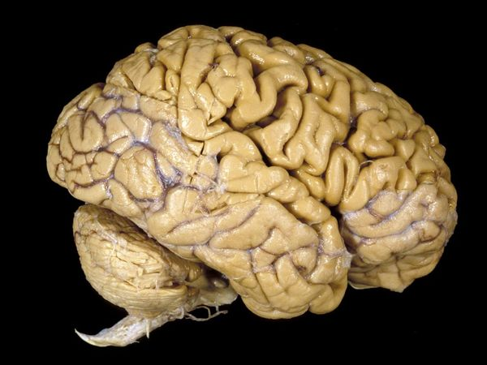
Neurological Foundations of MSM
  Stuss and Levine (2002) - this study compares dorsolateral frontal with the ventromedial frontal.
  Beer et al. (2003) – delineates how the orbitofrontal cortex connects emotions and identity
  Rameson and Lieberman (2007) – relates self image with medial frontal cortex
  Rolls and Grabenhorst (2008) - orbitofrontal cortex study which shows the difference between emotions and exhorter drive in terms of decision and reward.
  Chan et al. (2009) – illustrates the difference between left and right temporal lobes
  Damasio (2006) - somatic marker hypothesis – Explains relationship between physical sensation, personality, emotion, and ventromedial frontal
  Cohen and Frank (2009) – summarizes the function of the basal ganglia
  Parkinson et al. (2014) – right parietal contains spatial, temporal, and social map
  Zeki et al. (2014) – mathematical, visual, musical, and moral beauty all activate the same medial orbitofrontal region
  http://www.psych-it.com.au

Slide 9
From Personality to Linguistics
Analyzing how people function can be transposed onto linguistics
Cognitive Prerequisites for the Development of Grammar
Slobin (1973)

Slide 10
Phonemes,
Morphemes & Lexis
Lives in words; morphemes; core speech module
Analytical thought works with sequences (p. 191)
Emotion of order-within-complexity
  Use the right word
  Looks for general theories → overgeneralization (p.204)
  Hates exceptions to the rule (p. 205)
This student wants grammar and vocabulary

Slide 11
Syntax
Follows instructions; likes recipes; syntax
  Adds stability to words (p.199).
Observes and copies sequences
  Word order is copied (p.197)
Repeats sequences that work
  Avoid interrupting or rearranging linguistic units (p. 199)
Does one thing at a time
  Sentence structure is preserved as a closed entity (p. 200)
This student wants exercises

Slide 12
Semantics
Facts and connections; semantics
  Connects meaning to objects (words) (Lakoff & Johnson 1980)
  Hypocrisy is a mismatch between these two
Double meanings, puns, and novel metaphors
Limits domain of general Teacher theories
  Semantically consistent rules are acquired early (p. 206)
  Overgeneralizations are semantically constrained (p. 207)
Jumps to conclusions (implicature)
This student wants clarity and connections

Slide 13
Pragmatics
Lives in a world of emotional experiences
  ‘Who are you talking about?’
  Finds it difficult to comprehend abstract theory
Personal Identity
Non-verbal communication
  Accent and tone of voice
Aware of politeness and sincerity
This student wants illustrations that personalize

Slide 14
Great ad-lib speaker; motivates others
The ‘instant expert’ who uses ‘buzzwords’
Tends to exaggerate; sees the potential
Hates being bored or frustrated; DA (dopamine) and addiction
This student wants variety and excitement

Slide 15
Good at learning languages if motivated
Prefers the lecture—‘sit down and talk’
Skilled at reasoning and logic; hates failure
Lives on the edge; hates losing control
Technical thought; ‘rules of the game’
This student is competitive, wants structure

Slide 16
Experiments and adjusts within structure
  Does not like to feel muddled
  Avoids routine
Needs to know the mental context; aware of everything in the context
Thinks statistically: averages data, removes outliers
  ‘Cleanses’ and filters speech with euphemisms, (CSR)
This student wants incremental progress

Slide 17
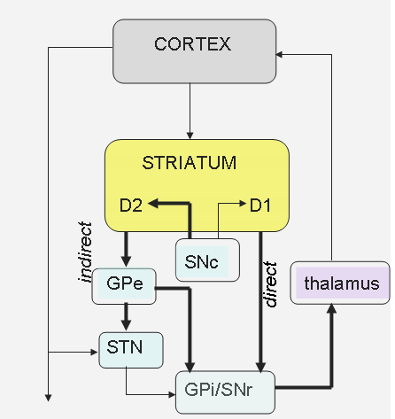
Basal Ganglia and Thalamus
Exhorter: Energy (DA) novelty, imagine, start. (direct path)
Contributor: Control, plan, optimize. (indirect path)
Facilitator: Adjust, blend, filter, average. (thalamus) (Briggs and Usrey, 2008)

Slide 18
Activity
Think of your teaching or research style. Which of these patterns fits you best?
Recall memorable students you have had. Which thinking patterns have they demonstrated and how did it make you feel?

Slide 19
Moving on → Linguistics, Pragmatics, Culture, Paradigms & Identity
Using Mental Symmetry as a meta-theory
Explains: key insights of TESOL and Christianity.
Helps: SLLs to navigate learning, culture & identity.
Applies: a new paradigm to personal transformation.
Information presented so far will provide the foundation for the rest of the presentation

Slide 20

Outline Pit Stop ...
Mental Networks—Friesen (2012)
A Mental Concept of God
Cognitive Science of Religion
Paradigms—Kuhn (1962)
Technical thought—Chomsky (1966)
Community of Practice—Lave and Wenger (1991)
Implicature—Grice (1975)
Politeness Theory—Arundale (1999, 2006)
Culture—Culhane (2004)
Childish identity—Piaget
The Limitations of Embodiment
Societal Stages—Habermas (1991)
Education and Faith
Critical Discourse Analysis—Fairclough (1999)
Cognitive Development—Perry (1970) & Belenky (1986)
Possible Selves—Higgins (1987)
Platonic forms and the Holy Spirit
Third Culture Kids—Pollock (2009)
EIL vs. EFL vs. WE—Matsuda (2012)
Incarnation
Three stages of personal salvation
The prayer of salvation
Multiple Worlds?

Slide 21
I. Mental Networks (MNs)
Friesen (2012, pp. 38-42)
Isolated memories feel good or bad
Similar emotional memories will connect
Triggering one memory activates them all
Compatible input creates hyper-pleasure
Continued incompatibility threatens the network
  There will be deep unease and sense of loss
  ‘Feeding’ the network removes unease
Painful memories can form MNs
A ‘starved’ network will ‘die’
  It will revert to isolated memories
Fairclough’s member’s resources (1989)

Slide 22
Two Kinds of MNs (Friesen, 2012)
Y = 2X² + 3X
English, Français…
Emotional Mercy experiences can form MNs (MMN)
  Culture, people, situations, and even objects
General Teacher theories can form MNs (TMN)
  Words form the building blocks for Teacher thought
  Paradigms are not purely rational (Kuhn, 1962)
  A TMN emotionally tries to impose its explanation
Two kinds of ‘culture shock’
  Incompatible experiences threaten MMNs (anomie)
  Paradigm shifts threaten TMNs – we apologize ☹
?
!
TMN
MMN
Science can’t exist without a paradigm (Kuhn, 1962)
  Science views religion as an ‘un-theory’
  Christianity needs to be presented as a cognitive paradigm

Slide 23
II. A Mental Concept of God
Religious Viewpoint
It is a person
  The Agency Detector
It is a person?!
A universal person
Outside space-time
Revealed through words
Holy
Just and Impartial
A mental concept of God
Corresponds to Christian God
Secular Viewpoint
The theory explains it
  Science
Theory applies to identity
Looks for generality
Explains many situations
Uses words and symbols
Hates exceptions
Independent of MMNs
A mental concept of God
Can be analyzed cognitively
TMN
MMN

Slide 24
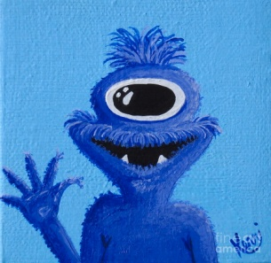
III. Cognitive Science of Religion (CSR)
MENTAL SYMMETRY
EVOLUTION
The CSR Agency Detector uses MMNs
  A rustle at night is a burglar or wild animal
Facilitator filter accepts minimally counterintuitive info
  Unicorns, Cyclops, superheroes, Greek gods (Barrett, 2004)
CSR looks for empirical evidence of natural religion
  It explains folk religion, but not transformation, theology, or God
CSR programs TMN with theory of evolution
  A theory that applies to identity creates an image of God
  Evolution becomes treated as a God-like universal agent
A cognitive theory is needed to explain a concept of God
  Evolution is an empirical theory, not a cognitive theory
  Eg. The problem of hard consciousness (Beauregard, 2007)
Mental symmetry explains concept of God cognitively
  This creates a concept of God consistent with Christianity
Evolution is a minimally counterintuitive theory (TMN)
  It is counterintuitive in the dimension of time
TMN
EVOLUTION
MMN

Slide 25
IV. Paradigms
Thomas Kuhn
normal abstract thought
  Kuhn’s Revolutionary science
  No cognitive mode in charge
  Partially formed Server sequences and Perceiver meanings
  Builds connections using metaphor
  Analog Certainty
  Build and expand theories
  Eg. Mental Symmetry
technical abstract thought
  Kuhn’s Normal science
  Contributor mode is in charge
  Well-formed Server sequences. (eg. F=ma)
  Defined Perceiver meanings
  (eg. Power = energy/time)
  Digital Certainty (eg. 3.14 vs. pi)
  Use rules within some paradigm
Same circuit running
a different way

Slide 26
→ Epistemological Crisis
Technical abstract thought is successful
  Math, logic, scientific theory, programming, grammar
It is emphasized in academia
  Specialization, PhD thesis, papers, vocabulary
It is limited
  It requires total certainty and builds upon axioms
  It limits thinking to a ‘restricted playing field’ – optimizes and improves
Using only it leads to an epistemological crisis
  Rigorous thought has been built upon a non-rigorous foundation
  Restricted playing fields do not lead to universal theories
  Transformation cannot be achieved with optimization
Kuhn’s revolutionary science is an epistemological crisis
  What is the alternative when technical thought fails?

Slide 27
V. Technical Thought → its
Overuse in Language
Chomsky’s generative grammar uses it (Ellis, 1998).
An epistemological crisis in studying language:
  Uses it: Rigorous typological analysis (Greenberg, 1975)
  More than it: Meaning comes from metaphor (Lakoff & Johnson, 1980)
An epistemological crisis in language teaching:
  The Past: teaching language = teaching grammar
  Opening Debate: acquisition ≠ learning (Krashen, 1982)

Slide 28
VI. Community of Practice (CoP) → Normal Abstract Thought Lave and Wenger (1991)
Creating Intellectual Capital (O’Donnell et al., 2003)
  Language can be viewed as a CoP (Hall, 2006)
  Abstract thought must function for CoP to emerge. Eg. Livemocha
CoP → normal abstract thought
  Informally bound by shared expertise; topics and people shift (p. 3,4). [≠Technical]
  Not managed in the traditional controlled manner (p. 4,8) [≠C]
  Defined by opportunities to learn, share, and critically evaluate; search for reasons, patterns and logic (p. 4,5). [gain T]
  Operates through ‘validity claims of propositional truth’ (p.7) [use P]
Team → technical concrete thought
  Clear boundaries, set rules, and memberships (p.4) [=Technical]
  Tightly managed and integrated, driven by deliverables (p.4) [C]
  Teleological, means-end or goal-oriented (p.4) [M goal]
  Team managers threaten the function of CoP (p.8) [C↑]

Slide 29
SUMMARY
Both abstract and concrete technical thought work within limited fields
MNs function emotionally
Normal thought uses analogy to integrate thought
Using a theory forms a TMN
Using a plan forms an MMN
MNs become apparent when the field is questioned
An adequate concept of God uses the analogies of normal thought
Abstract Technical Field
TMN
MN
Concrete Technical Field
MMN

Slide 30
VII. Implicature
Implicature goes beyond both normal and technical thought
→ it was first analyzed using technical thought (Grice, 1975).
  The cooperative principle: Guided by a Teacher theory
  Maxim of quantity: Pursue Teacher order-within-complexity
  Maxim of quality: Convey Perceiver meaning
  Maxim of relation: Stay within the Contributor playing field; be relevant
  Maxim of manner: Use well-formed Server statements
However, technical thought cannot explain implicature
→ post-Griceans
  Grice is not including social interaction (Lindblom, 2001)
  Grice has a logical bias (Davies, 2007)
  Children do implicature but lack technical thought (Sperber & Wilson, 2002)
Implicature: Triggered MNs will ‘fill in the blanks’ (Fairclough’s MR)
  It is cognitively efficient (Sperber, 2002)
  It attempts to influence others (p. 21)
  It assumes relevance (p. 24)

Slide 31
VIII. Politeness Theory
Technical thought cannot explain politeness (Arundale, 1999).
  Uses a co-constituting model for implicature and politeness.
Politeness is the emotional side of MMNs
  Identity is a set of MNs in my mind
  I also represent others within my mind using MNs
MNs have three main attributes:
  A MN should not be suppressed (I exist).
  A MN wants input consistent with its structure (Allow me to function).
  A MN should contain memories with good emotions (Be nice).
These attributes explain the three aspects of politeness theory:
  Positive face = activate MN with consistent, positive data
  Negative face = suppress, ignore or override MN
  Negative politeness = activate MN without imposing your structure

Slide 32
IX. Culture
Social interaction is based in interacting MNs (Friesen, 2012)
  No ‘social brain cells’; Insufficient bandwidth.
    Without human minds there can be no social interaction
  Most social interaction is internal between MNs.
  External interaction triggers and updates these MNs.
  Fairclough (1999) agrees; Fairclough (2003) does not.
Culture is a shared set of MNs that resonate
  Most were acquired in childhood
Core MNs impose structure on lesser MNs
  Power struggles between core MNs
Cross-cultural interactions trigger inconsistent MNs
  Culture Shock

Slide 33




Social Interaction and MNs
Jack: “Jill, what if we make pizza?”
Jill: “The last time ...”
Jill is communicating with Jack at three different levels:
She is interpreting what (the words) he is saying.
The MN in her mind representing him predicts his response.
Her MNs are being triggered by one or two words in the conversation.
Jack: “Don't worry, we'll order pizza.”
The MN that predominates depends on context as well as the emotions and choices of listener. [e.g. Gender roles in example]

Slide 34
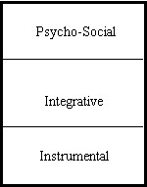
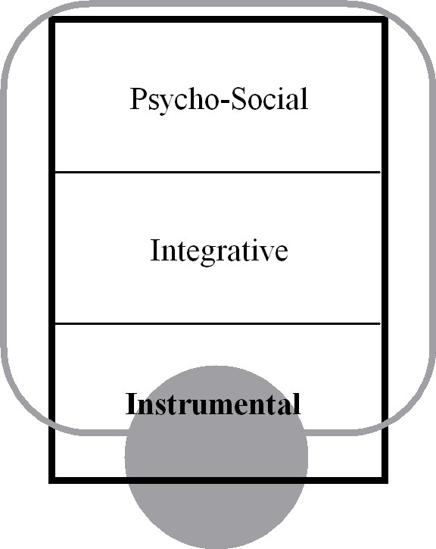
Intercultural Interaction Model
Acculturation Attitudes in SLA (Culhane, 2004)
Psycho-social: Core MNs are affected
Integrative: Peripheral MNs are affected
Instrumental: MNs are not involved
Marginalized
No L2/C2 MNs have formed
→ Leaving C2 may uncover acquired MNs.
L1/C1
L2/C2

Slide 35
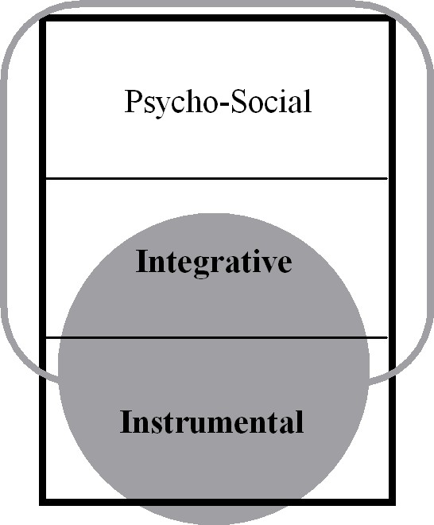
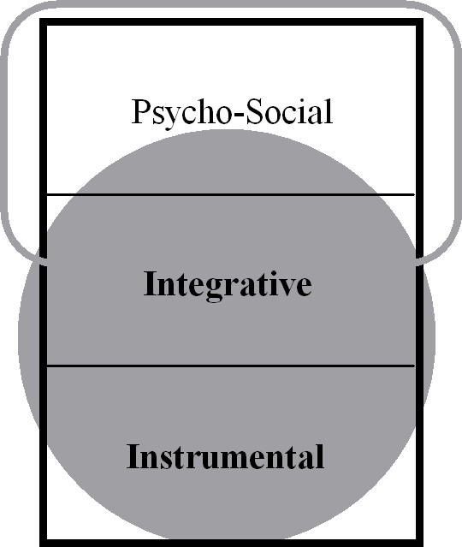
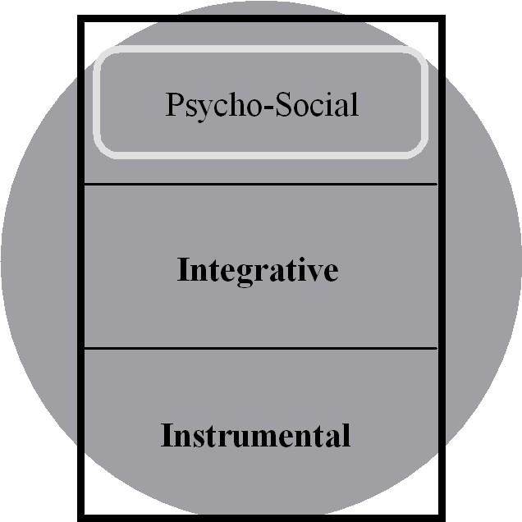
Separated
Peripheral MNs of L2/C2 acquired, but core MNs of L1/C1 drive behaviour.
→ Appears to be integrated because C1 is not public.
Integrated
Some core MNs of L2/C2 have been acquired.
Multi-cultural
F used to mix between cultures
Assimilated
Only core MNs of L1/C1 remain.
→ Further assimilation will threaten core MNs and may trigger a backlash.

Slide 36
X. Piaget and the Childish Mind
Childish Thought: Largely defined by MMNs
  Pretense is basis for Theory of Mind (Leslie, 1987)
  Pretense plays major role in child (Piaget, 1972)
  Children are guided by schema (Piaget, 1926)
Preoperational stage: fragmented MMNs
  The environment and body trigger MMNs
Concrete operational stage: TMNs from MMNs
Formal operational stage: independent TMNs
Identity = MMNs that cannot be ignored
TMN
MMN
MMN

Slide 37
XI. The Limitations of Embodiment
Embodiment creates initial mental content—and ‘sin nature’
  The body urges the mind to take shortcuts
Hedonism: physical pleasure creates isolated MMNs
  Satisfy physical desire regardless of consequences; overeating
Identification: use environment to focus on good MMN
Shortcuts: use external structure to substitute for mental content
  Use object, money, and people to avoid learning and growing
Theft: Take objects that triggers good MMNs
Denial: change environment to avoid painful MMN
  Moving on, divorce
Irrationalism: use MMNs to overwhelm Perceiver thought
Power struggles: MMNs fight for domination; murder
Xenophobia: avoid or suppress those who trigger different MMNs
Embodiment is an inadequate philosophy
Embodiment is an effective tool to guide the mind, eg. parents

Slide 38
XII. Societal Stages
Habermas
A Cognitive Examination of his first two stages
Habermas describes a mental shift involving Mercy and Perceiver
  Mercy thought remembers emotional experiences
  Perceiver thought looks for facts—which organize and connect Mercy experiences
1. Representative publicity—Rote Learning (M emotions overwhelm P)
  The emotional status of the leader is paramount—aura
  This emotional status of MNs overwhelms Perceiver thought
  Front 1/3 of hippocampus connects with amygdala (Fanselow, 2010)
2. Bourgeois public sphere—Critical Thinking (P is functioning)
  Perceiver facts no longer accepted blindly; facts are tested in debate
  Perceiver thought functions independently of Mercy emotions in rule of law
  Perceiver facts connect Mercy experiences through travel, trade, and news
  Perceiver facts define private property and personal identity
  Back 1/3 of hippocampus independent of amygdala (Fanselow, 2010)
  London taxi cab drivers have larger posterior right hippocampus (Maguire, 2003)

Slide 39


XIII. Education and Faith
Emotional experiences can create MMNs
  Idolatry is based on defining experiences
These MMNs can overwhelm Perceiver thought
  Rote learning is revealed by authorities
  Childish thought begins with rote learning
Teacher theories require solid facts
  Written revelation makes facts appear solid
Teacher thought universalizes facts
  Facts appear universal if many authorities agree
Critical thinking questions authorities
  Perceiver thought will stop being overwhelmed
  The ‘great accommodation’ from ‘unequivocal learning’ (Love & Guthrie, 1999)
Blind faith uses MMNs to re-overwhelm P; self-denial
Multi-culturalism averages opinions using Facilitator filter
Cross-culturalism uses P to look for repeated connections
  This requires mental ‘traveling’
?
Perceiver
!!!
MMN
???

Slide 40
Brief Reflection
Recall a situation in which religious experience overwhelmed critical thought.
In hindsight, was this helpful or harmful?

Slide 41

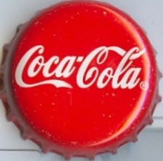
XIV. Language & Power (Fairclough, 1999)
The Deception of Civilization
1) Natural law is based in physical cause-and-effect
Understanding nature makes it possible to control nature
  Civilization blocks natural cliffs with artificial fences
  Goods are purchased in stores from people
The next generation encounters civilization – not nature
L&P: Power groups based in MMNs fight each other
  Each group imposes its version of Perceiver truth
2) Technology enables economy of scale and globalization
The next generation encounters big gov’t and business
  Habermas’ third stage
Those in power will think they are above the law
  They use their power to make laws that exclude others
Average people have no knowledge of natural law
  They accept truth proclaimed by those in power
L&P: Universal theory is ideology based in power groups
  Scientific law is ignored because people interpret it
Perceiver
MMN
MMN

Slide 42
Personal (dis)Honesty
Childish MMNs are flawed and need transforming
Childish MMNs overwhelm Perceiver thought
  I am special, facts do not apply to me, there is no truth
Childish MMNs stop Teacher thought
  ‘Identity is too complex to be understood’ (Norton, 1997)
Childish MMNs shape TMNs; god in my image (Fairclough, 1999)
Transformation requires TMNs that change MMNs
  Allowing a concept of God to change me
  T pleasure of understanding balances M pain of honesty
Scientific shortcut: use empirical facts to build TMN
  Scientism ignores cognitive sources of thought and action
Understanding should be internalized and applied subjectively
  This will create a mental concept of God
Religious shortcut: use revelation to build concept of God
  The MMN source of truth overpowers the MMN of identity
  The MMN source of truth is not questioned
  Childish identity is suppressed rather than transformed
Truth should be universalized and understood
BIG MMN
ME
TMN
Perceiver
MMN
An image of God should be based in a TMN

Slide 43
XV. Cognitive Development
(Love & Guthrie 1999)
Male: Perry (1970)
Males ignore MNs to develop P.
Dualism: P is mesmerized by MNs
Multiplicity: P is not mesmerized but also not functioning
Procedural Knowledge: P is functioning
Constructed Knowledge: P applies increasingly to MNs
Female: Belenky (1986)
Females learn to manipulate MNs.
Silence: Other MNs suppress identity
Received Knowledge: Other MNs define identity
Subjective Knowledge: MNs define P ‘truth’
Procedural Knowledge: P evaluates MNs
Constructed Knowledge: P manipulates MNs

Slide 44
XVI. Possible Selves
→ Any MN is potentially a self
MNs that are always repeated are inescapable
  Defined by the physical body, knowledge, and skills
  The ‘actual self’ (Higgins, 1987); intrinsic motivation
  Perceiver confidence is required to recognize this inescapability
MNs with strong emotions feel inescapable—if triggered
  Defined by parents, culture, and authority figures
  The ‘ought self’ (Higgins, 1987); extrinsic motivation
  Many inconsistent MNs since Perceiver thought overwhelmed
  Triggered mainly by others when violated (Dornyei, 2009)
  → Ought self = MNs in my mind others use to control me
Some MNs contain painful experiences (feared self)
Perceiver confidence increases ability to manipulate MNs
  Core MNs can only be changed by playing one against another

Slide 45
Semantic Shifting
TESOL studies linguistics and culture (Norton, 1997)
  TMNs and MMNs affect each other indirectly
Perceiver thought combines object recognition and meaning
MMNs of culture affect object recognition
  Learning foreign meanings may question MMNs (Citron, 1995)
TMNs of language affect object recognition
  Paradigms alter seeing; incommensurability (Kuhn, 1962)
  Thinking and dreaming in French led to ‘anomie’ (Lambert, 1972)
Shaky MMNs help language learning
  Perceived social distance helps language acquisition (Acton, 1979)

Slide 46
XVII. The ‘Ideal’ Possible Self
Questions: What are the mechanisms behind Dornyei’s (2009) ideal self?
What makes a possible self ideal, realizable, stable and intrinsic?
The ideal self is based in Platonic forms:
P groups M experiences using object recognition; “I see circles”
T describes the essence of the object; “A circle is equidistant…”
The T theory adjusts the P fact through semantic shifting.
The adjusted P fact creates an invisible, ideal M image; “The perfect circle”
Perceiver Category
Teacher Theory: “A circle is equidistant from the center.”
Semantic shifting
Mercy Experiences

Slide 47
Divine Spirit—a Universal MMN
Holy Spirit
Platonic forms come from facts idealized by Teacher thought
Teacher theories lead to more abstract Platonic forms
A universal Teacher theory leads to Plato’s form of the Good
This is the image of a Spirit of Truth that comes from God
The structure is internal
Spirit of the World
We live in an environment
  Nature, city, society
This creates an image of universality
The structure is external
Spirit of the World
Holy Spirit
Love
Justice

Slide 48
Platonic Forms and Identity
Utopia = eu-topia + ou-topia
(good) (not)
Combines idealism with realism
Platonic forms idealize reality
  ‘Thy will be done…’
The ideal self motivates the actual self
  Migration & mass media expand imagined communities (Kanno and Norton, 2003)
Platonic forms must be realized
  ‘…on earth as in heaven’
The actual self realizes the ideal self (Dornyei, 2009, p. 18)
  Use facts to apply ideal self to specific situation
What is thought of as a Platonic form is often a more socially approved form of ought self

Slide 49
XVIII. Third Culture Kids (Pollock, 2009)
Dislocated MNNs in childhood
  New incompatible MMNs;
  different = bad; I am bad!
Under ‘sending organization’
Live under TMN
Core
Less mature than average
Emotions inhibit P thought
Suppress painful memories
Habermas’ first stage
Poor sense of identity
Delayed teen rebellion
Multi-cultural chameleon
Uneven Maturity
Periphery
More mature than average
P learns cross-cultural facts
T gains understanding
Habermas’ second stage
Confident and flexible
Platonic form of culture
  81% of TCKs earn at least Bachelor’s degrees vs. 21% (Cottrell & Unseem, 1993)

Slide 50
TCK: Three Possible Viewpoints
Understand the External Situation (Fairclough, 1999)
TCKs experienced childhood cultural power struggles
TCKs both lived under ideology and proclaimed ideology
One either submits to messages or struggles against them
How can I proclaim my message more effectively?
TMN
Understand the Internal Situation (Pollock, 2009)
Traumatized childish MMNs need to be labeled and understood
Understanding comforts but leaves core MMNs unchanged
    ‘Migratory instinct’; air of superiority; lack of identity;
    TCK -> Adult TCK
How did proclaiming a message affect me?
SOCIETY
Use Understanding to Transform Personal Identity
TMNs helped to transform peripheral MMNs
This peripheral maturity can be extended to core MMNs
  Acquire cross-cultural Perceiver facts about people & identity
  Follow a cross-cultural meta-culture by means of Platonic forms
How can understanding the message transform us?
MMN

Slide 51
XIX. EFL vs. EIL (Matsuda, 2012)
EFL:
Linked to cultural MMNs
EIL:
Linked to Int’l TMNs
Teach native accent
Learn local idioms
Embrace local culture
Become multi-cultural
Follow inner-circle countries
Adopt new identity
Emphasize intelligibility
Minimize idioms
Pursue int’l culture
Become cross-cultural
Pursue ‘utopia’
Guide actual self by ideal self
L2 learners naturally view English as an international language of communication that is separate from local language and culture. (Kumaravadivelu, 2012)

Slide 52
Perspectives on World English
External Viewpoint
English is ‘ideology’ from inner-circle countries (Fairclough, 1999)
Inner circle NS → a linguistic advantage—fluid, native accent
Expanding circle NNS → Needs to redefine ‘correct English’ to remove guilt (Sharifian, 2012)
Cognitive Viewpoint
EIL is guided by int’l TMN, not cultural MMNs
NNS → a cognitive advantage—views English cross-culturally
Inner circle NS → Needs to separate English from cultural MMNs to develop cross-cultural thinking
An external focus removes the NNS cognitive advantage and deconstructs EIL
A cognitive focus empowers the NNS and transcends L1 culture

Slide 53






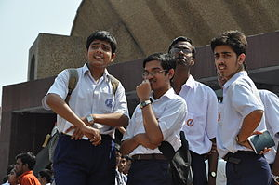
EFL → MMNs
Specific culture
Ethnic identity
Accent
EIL → TMNs
Intercultural
experience
International
community
Intelligibility
TMNs/MMNs
Don’t confuse
Separate general
from specific

Slide 54

XX. Incarnation
Jewish Thought
God works in history
T words and S rituals
God is found in Jewish life
Greek Thought (Gunton, 2002)
God is universal perfection
P facts and Platonic forms
God is static & immutable
Server—Contributor—Perceiver
Scientific Thought
Uses Contributor cause-and-effect
Reaches a goal in concrete thought
Builds a theory in abstract thought
Philippians 2:5-11
Jesus matches Contributor person
Jesus followed plan of salvation
Jesus was given highest name
SAME

Slide 55
XXI. Three Stages of Personal Salvation
1. Law in the Heart
Allow facts to analyze MMNs
Build a TMN concept of God
Teacher pleasure offsets Mercy pain
Perceiver side of incarnation
2. Becoming Righteous
Go beyond words to actions
Allow TMN to guide actions
Teacher drive replaces Mercy goal
  Kant’s Categorical Imperative
Server side of incarnation
3. Dying to self
Allow old MMNs to fall apart
Live in MMNs of new identity
Mercy goals are transformed
  Beyond Kant’s Cat. Imperative
Identify with Contributor incarnation
The Internal World can now transform the External World

Slide 56
An Integrated View of Salvation
Scientific Viewpoint
Study universal natural law
Construct a rational TMN
Transforms physical world
Scientific→ Industrial→ Consumer revolution
Can sidetrack into scientism
Religious Viewpoint
Believe in God
Touch MMNs of identity
Changes hearts
Justified→ Sanctified→ Not I but Christ
Can sidetrack into mysticism
Cognitive Viewpoint
Construct a universal, personal concept of God
Allow TMN of understanding to transform MMN of identity
Leads to mental wholeness which forms a healthy society
Understanding→ Application→ Transformation
Cognitive mechanisms are universal, inescapable, and personal
The extent of a person’s salvation depends upon the universality of his concept of God

Slide 57
XXII. The Prayer of Salvation
This prayer makes it possible to follow the cognitive path
TMN sees childish MMNs as lawless chaos
Salvation prayer inserts C plan between TMN and MMN
  MMN identifies with plan = ask Jesus into my heart
  MMN submits to plan = make Jesus my Lord
  TMN sees plan not identity = pray in Jesus’ name
  TMN sees generality of plan = justification
Enrolling in a school as an analogy
  The curriculum is a general Teacher structure
  The curriculum is also a personal path for Mercy identity
  The child is seen as a student of the school
Salvation prayer enrolls identity in school of salvation
  It produces a feeling of sins being forgiven by God
  ‘Peace with God’ depends upon remaining a student
  Supernatural intervention was needed to establish the school
Normal thought unfolds the technical plan of salvation
  Christ is the head; the church is the body
TMN
MMN

Slide 58
XXIII. Multiple Worlds?
A theology that ignores the supernatural is ultimately scientism in disguise
Human World
Compatible with concrete thought
Mercy handles experiences
Server performs actions
This is known from observation
Angelic World?
Compatible with abstract thought
Teacher handles names
Perceiver has power to transform
Angels have missions & deliver messages
Spiritual World?
Compatible with MNs
MNs drive the mind
Evil spirits lack content and want to possess bodies
Love holds things together
Acts 23:8,9: …a spirit or angel spoke to…

Slide 59
Summing Up
We are converging to spirituality without theology
  Folk religion is now studied secularly (CSR, CERC at UBC)
  Christians are seeking experience and sacrament
  The average person is looking for non-physical meaning
Theology is needed for personal transformation
  Christianity says that a person is saved through belief
  Children are educated with propositional content
  A TMN is needed to transform childish MMNs
A cognitive approach makes theology discussable
  Based in cognitive mechanisms and not holy books
  Building a concept of God rather than proclaiming one
TESOL is forced to deal with culture, language & identity

Slide 60
Thank you
for your kind attention
http://www.mentalsymmetry.com/tesol.php
(go to downloads for powerpoint)
Youtube video will be posted
Lorin Friesen & Angelina Van Dyke

Slide 61
References
Acton, William (1979). Second language learning and perception of difference in attitude. Unpublished doctoral dissertation, University of Michigan.
Acton, William (1984). Changing fossilized pronunciation. TESOL Quarterly, 18(1), 71-85.
Acton, William (2013). e-Motional methods: cognitively complex, hands-on teaching and learning.
Arundale, Robert B. (1999). An alternative model and ideology of communication for an alternative to politeness theory. Pragmatics, 9(1), 119-153.
Arundale, Robert B. (2006). Face as relational and interactional: A communication framework for research on face, facework and politeness. Journal of Politeness Research, 2, 193-216.
Barrett, Justin. (2004) Who Would Believe in God? Lanham, MD: Ultimira Press.
Beauregard, Mario and O’Leary, Denyse. (2007). The Spiritual Brain: A Neuroscientist’s Search for the Existence of the Soul. New York, NY: Harper Collins
Beer, Jennifer S. et al.(2003). The regulatory function of self-conscious emotion: Insights from patients with orbitofrontal damage. Journal of Personality and Social Psychology, 85(4), 594–604.
Belenky, M.F., Clinchy, B. M., Goldberger, N.R., Tarule, J.M. (1986). Women’s ways of knowing: The development of self voice and mind. New York: Basic Books Inc. http://collegestudentdeveltheory.blogspot.ca/2010/10/womens-ways-of-knowing-synopsis-by-e.html
Briggs, Farran and Usrey, Martin W. (2008) Emerging views of corticothalamic function. Current Opinions in Neurobiology, 18(4), 403–407. doi:10.1016/j.conb.2008.09.002.
Chan, Dennis et al. (2009). The clinical profile of right temporal lobe atrophy. BRAIN: a Journal of Neurology, 132, 1287-1298.
Chomsky, Noam. (1966). Topics in the Theory of Generative Grammar. The Hague, The Netherlands: Mouton and Co.
Cohen, Michael X. and Frank, Michael J. (2009). Neurocomputational models of basal ganglia function in learning, memory and choice. Behavioural Brain Research, 199(1), 141–156.
Cook, Vivian. Krashen’s Comprehension Hypothesis Model of L2 Learning. Retrieved from http://homepage.ntlworld.com/vivian.c/SLA/Krashen.htm

Slide 62
Cottrell, A.B. and Useem, R.H. (1993). TCKs four times more likely to earn bachelor's degrees. NewsLinks-The Newspaper of International Schools Services, 7(5), Princeton, NJ.
Culhane, S.F. (2004). An intercultural interaction model: Acculturation attitudes in second language acquisition. Electronic Journal of Foreign Language Teaching, 1(1). Retrieved from http://e-flt.nus.edu.sg/v1n12004/culhane.htm#3%20%20Acculturation%20attitudes
Damasio, Antonio. Descarte’s Error. (1994, 2006). USA: Penguin Books, getAbsract.
Damasio, Antonio. (1999). The Feeling of What Happens: Body and Emotion in the Making of Consciousness. London: Heinemann.
Davies, Bethan L. (2000). Grice’s Cooperative Principle: getting the meaning across. Leeds Working Papers in Linguistics, 8, 1-26.
Davies, Bethan L. (2007). Grice’s Cooperative Principle: Meaning and rationality. Journal of Pragmatics, 39, 2308-2331.
Davis, Wayne. (2007). Implicature: Intention, convention, and principle in the failure of Gricean theory.
Dörnyei, Zoltán. (2009). The L2 Motivational Self System. In Motivation, Language Identity and the L2 Self. Ed. Zoltán Dörnyei and Ema Ushioda. Bristol, UK: Multilingual Matters. 9-42.
Ellis, Nick C. (1998). Emergentism, connectionism and language learning. Language Learning 48(4), 631–664.
Fairclough, N. (1989). Language and Power. Edinburgh, UK and New York, NY: Longman.
Fairclough, N. (2003). Analyzing Discourse: Textual Analysis for Social Research. London: Routledge.
Fanselow, Michael and Dong, Hong-Wei (2010). Are The Dorsal and Ventral Hippocampus functionally distinct structures? Neuron, 65(1), 7.
Fodor, J. A. (1983). Modularity of Mind: An Essay on Faculty Psychology. Cambridge, MA: MIT Press.

Slide 63
Fortune, D. and Fortune K. (1987, 2009). Discover Your God-Given Gifts. Grand Rapids, MI: Chosen Books.
Friesen, Lane. (1986). Cognitive Styles in History: Perceiver and Mercy, First Ed. Lane Friesen, Inc.
Friesen, Lane. (1986). Cognitive Styles in History: Contributor and Server, First Ed. Lane Friesen, Inc.
Friesen, Lorin. (2012). God, Theology, and Cognitive Modules: A General Theory of Human Thought. Abbotsford, BC: Lorin Friesen.
Greenberg, Joseph H. (1975). Research on Language Universals. Annual Review of Anthropology, 4, 75-94.
Grice, Paul. (1989). Studies in the Way of Words. Harvard, USA: Harvard UP. Chapter 2: Logic and Conversation.
Gregg, Kevin R. (2003) The state of emergentism in second language acquisition. Second Language Research, 19(2), 95-128.
Gregg, Kevin R. (2006). Taking a social turn for the worse: the language socialization paradigm for second language acquisition. Second Language Research 22(4), 413–442.
Gunton, C. (2002).
Habermas, Jürgen. (1991). The Structural Transformation of the Public Sphere: An Inquiry into the Category of Bourgeios Society. Cambridge, MA: MIT Press.
Hakansson, Gisela; Pienemann, Manfred; Sayelhi, Susan. (2002) Transfer and typological proximity in the context of second language processing. Second Language Research, 18(3), 250-273.
Higgins, Tory E. (1987). Self-discrepancy: A theory relating to self and affect. Psychological Review, 94(3), 319-340.
Jackendoff, Ray. (2002). Foundations of Language: Brain, Meaning, Grammar, Evolution. New York: Oxford UP.
Kanno, Yasuko and Norton, Bonny. (2003). Imagined communities and educational possibilities: Introduction. Journal of Language, Identity and Education, 2(4), 241-249.

Slide 64
Krashen, Stephen. (1982). Principles and Practice in Second Language Acquisition. University of Southern California.
Kubota, Ryoko. (1999). Japanese culture constructed by discourses: Implications for applied linguistics research and ELT. TESOL Quarterly, 43(1), 9-35.
Kuhn, Thomas S. (1962). The Structure of Scientific Revolutions. Chicago UP, 1962, 1970, 1996.
Kumaravadivelu, B. (2012). Language Teacher Education for a Global Society: A Modular Model for Knowing, Analyzing, Recognizing, Doing and Seeing. New York: Routledge.
Lakoff, George and Johnson, Mark. (1980). The metaphorical structure of the human conceptual system. Cognitive Science, 4, 195-208.
Lambert, W. (1972). Language, Psychology and Culture: Essays. Stanford: Stanford UP.
Lave, J. and Wenger, E. (1991). Situated Learning: Legitimate Peripheral Participation. Cambridge: Cambridge UP. First published in 1990 as Institute for Research on Learning report. 90-0013.
Leudar, Ivan; Costall, Allan; Francis, Dave. (2004) Theory of mind: A critical assessment. Theory and Psychology, 14, 571.
Leslie, Alan M. (1987). Pretense and representation: The origins of “Theory of Mind”. Psychological Review, 94(4), 412-426.
Lightbown, Patsy M. and Spada, Nina. (2006). How Languages are Learned, 3rd ed. Oxford: Oxford UP.
Lindblom, Kenneth. (2001). Cooperating with Grice: A cross-disciplinary meta-perspective on uses of Grice’s cooperative principle. Journal of Pragmatics, 33, 1601-1623.
Love, P. G., and Guthrie, V. L. (Eds.). (1999). Understanding and applying cognitive development theory (New Directions for Student Services No. 88). San Francisco: Jossey-Bass.
Maguire, E.A, et.al. (2003). Navigation Expertise and the Human Hippocampus: A Structural Brain Imaging Analysis. Hippocampus, 13:208-217.
Nisbett, Richard E.; Choi, Incheol; Peng, Kaiping; Norenzaya, Ara. (2001). Culture and systems of thought: Holistic versus analytic cognition. Psychological Review, 108(2), 291-310.
Norton, Bonny. (1997). Language, identity and ownership of English. TESOL Quarterly, 31(3), 409-429.

Slide 65
Norton, Bonny. (2000) Identity and Language Learning: Identity, Gender Ethnicity and Educational Change. Language in Social Life Series. Ed. Christopher N. Candlin. Harlow, England: Longman Pearson Education.
Norton Pierce, Bonny. (1995). Social Identity, Investment and Language Learning. TESOL Quarterly, 29(1), 9-31. Norenzaya, Ara and Heine, Steven J. (2005). Psychological universals: What are they and how can we know? Psychological Review ,131(5), 763-784.
Nuckolls, Janis B. (1993). The semantics of certainty in Quechua and its implications for a cultural epistemology. Language in Society, 22(2), 235-255.
O’Donnell et al. (2003). Creating intellectual capital: A Habermasian community of practice (CoP) Introduction. Journal of European Industrial Training, 27(2,3,4), 80-87.
Parkinson, C., Lui, S. and Wheatley, Thalia. (2014). A Common Cortical Metric for Spatial, Temporal, and Social Distance. The Journal of Neuroscience, 34(5), 1979-1987.
Perry, Bill. (1970). Forms of Intellectual and Ethical Development in the College Years: A Scheme. New York: Holt, Rinehart and Winston
Petitto, Laura-Ann and Dunbar, Kevin. (2004). New findings from Educational Neuroscience on Bilingual Brains, Scientific Brains, and the Educated Mind. MBE/Harvard, 1- 20
Piaget, J. (1926). The Language and Thought of the Child: Harcourt, Brace & Co.
Piaget, J. (1972). The Psychology of the Child. New York: Basic Books.
Pollock, David C. and Van Reken, Ruth E. (2009). Third Culture Kids: Growing up Among Worlds. Rev. Ed. Boston, MA: Nicholas Brealey Publishing.
Rameson, Lian and Lieberman, Matthew D. (2007). Thinking about the self from a social cognitive neuroscience perspective. Los Angeles: University of California, Department of Psychology.
Rolls, Edmund T. and Grabenhorst, Fabian. (2008 ). The orbitofrontal cortex and beyond: From affect to decision-making. Progress in Neurobiology, 86, 216–244.
Scovel, Tom. (2001). Learning New Languages: A Guide to Second Language Learning. Boston: Heinle

Slide 66
Sharifian, Farzad and Marlina, Roby. (2012). English as an International Language (EIL): An Innovative Academic Program. In Aya Matsuda (Ed.) Principles and Practices of Teaching English as an International Language (140-153). UK, USA, Canada: Multi-lingual Matters .
Slobin, Dan I. (1973). Cognitive pre-requisites for the development of grammar. Studies of child language development. C. A. Ferguson and D.I. Slobin (Eds.). New York: Holt, Rinehart and Winston.
Sperber, Dan and Wilson, Deidre. (2002). Pragmatics, modularity and mind-reading. Mind and Language, 17, 3-23.
Stuss, Donald T. and Levine, Brian. (2002). Adult clinical neuropsychology: Lessons from studies of the frontal lobes. Annual Psychological Review, 53, 401–33.
Tocalli-Beller, Augustina and Swain, Merrill. (2005). Reformulation: The cognitive conflict and L2 learning it generates. International Journal of Applied Linguistics, 15(1), 5-28.
Ullman, Michael T. et al. Neurocomputational models of motor and cognitive deficits in Parkinson’s disease. Progress in Brain Research, 183, 275-297.
Zeki, et al. (2014) The experience of mathematical beauty and its neural correlates. Frontiers in Human Neuroscience, 8(68).

