Slide 1
Cognitive Modeling for Critical Cross-Cultural Learning
Angelina Van Dyke and Lorin Friesen
BC TEAL 45th Conference
Brain-Compatible Language Learning Douglas College, New Westminster
2013

Slide 2
A Meta-Cognitive Functional Analogical Approach
Meta: An integrated framework
  This can bring theoretical unity to TESOL.
Cognitive: Interacting cognitive modules
  Modules correspond to brain regions.
Functional: Cognitive mechanisms
  How can the mind function?
Analogical: Comparing how the mind functions
  How research, teaching, identity, and culture interact
Mental Symmetry Model: Analyze many fields
  Each field provides corroborative evidence.

Slide 3
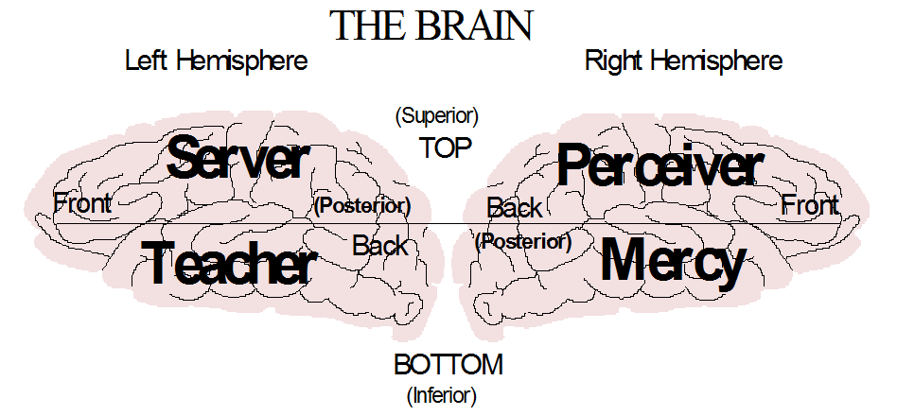
Mercy: Remembers emotional experiences; forms personal identity.
Teacher: Remembers words; builds general theories
  Data: temporal; processor: amygdala; internal structure: ventral frontal
Perceiver: Looks for repeated connections; facts, objects, and maps
Server: Looks for repeated sequences; performs actions.
  Data: parietal; processor: hippocampus; internal structure: dorsolateral frontal

Slide 4
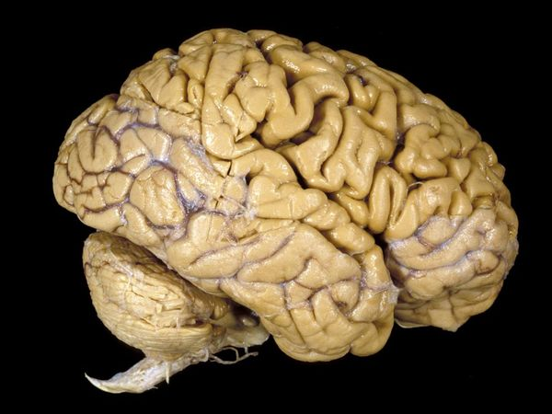
Neurological Foundations of MSM
  Stuss and Levine (2002) - this study compares dorsolateral frontal with the ventromedial frontal.
  Beer et al. (2003) – delineates how the orbitofrontal cortex connects emotions and identity
  Rameson and Lieberman (2007) – relates self image with medial frontal cortex
  Rolls and Grabenhorst (2008) - orbitofrontal cortex study which shows the difference between emotions and exhorter drive in terms of decision and reward.
  Chan et al. (2009) – illustrates the difference between left and right temporal lobes
  Damasio (2006) - somatic marker hypothesis – Explains relationship between physical sensation, personality, emotion, and ventromedial frontal
  Cohen and Frank (2009) – summarizes the function of the basal ganglia

Slide 5
From Personality to Linguistics
Analyzing how people function can be transposed onto linguistics
Cognitive Prerequisites for the Development of Grammar
Slobin (1973)

Slide 6
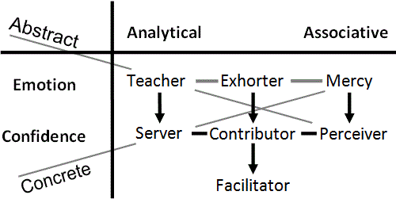
Phonemes,
Morphemes & Lexis
Lives in words; morphemes; core speech module
Analytical thought works with sequences (p. 191)
Emotion of order-within-complexity
  Use the right word
  Looks for general theories → overgeneralization (p.204)
  Hates exceptions to the rule (p. 205)

Slide 7
Syntax
Follows instructions; likes recipes; syntax
  Adds stability to words (p.199).
Observes and copies sequences
  Word order is copied (p.197)
Repeats sequences that work - collocations
  Avoid interrupting or rearranging linguistic units (p. 199)
Does one thing at a time
  Sentence structure is preserved as a closed entity (p. 200)

Slide 8
Semantics
Facts and connections; semantics
  Connects meaning to objects (words) (Lakoff & Johnson 1980)
  Hypocrisy is a mismatch between these two
Double meanings, puns, and novel metaphors
Jumps to conclusions (implicature)
Limits domain of general Teacher theories
  Semantically consistent rules are acquired early (p. 206)
  Overgeneralizations are semantically constrained (p. 207)

Slide 9
Pragmatics
Lives in a world of emotional experiences
  ‘Who are you talking about?’
  Finds it difficult to comprehend abstract theory
Personal Identity
Non-verbal communication
  Accent and tone of voice
Aware of politeness and sincerity

Slide 10
Great ad-lib speaker; motivates others
The ‘instant expert’ who uses ‘buzzwords’
Tends to exaggerate; sees the potential
Hates being bored or frustrated; DA (dopamine) and addiction
  Parkinson’s Disease (DA↓), Exhorter is disabled (Wiecki and Frank, 2010)
  LH Parkinson’s (DA↓) deficient at verb generalization (T→E) (Ullman et al., 1997, p. 272)

Slide 11
Good at learning languages if motivated
Prefers the prepared lecture
Prefers to ‘sit down and have a talk’
Skilled at reasoning and logic; hates failure
Lives on the edge; hates losing control
Technical thought; ‘rules of the game’

Slide 12
Experiments within a fixed structure; does not like routine
Does not like to feel muddled; develops rules and procedures to facilitate
‘Cleanses’ and filters speech with euphemisms
Needs to know the mental context; aware of everything in the context

Slide 13
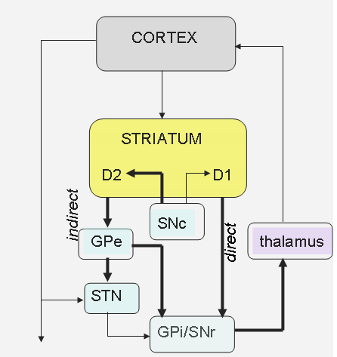
Basal Ganglia and Thalamus
Exhorter: Energy (DA) novelty, imagine, start. (direct path)
Contributor: Control, plan, optimize. (indirect path)
Facilitator: Adjust, blend, filter, average. (thalamus) (Briggs and Usrey, 2008)

Slide 14
Activity
Think of your teaching or research style. Which of these patterns fits you best?
Recall memorable students you have had. Which thinking patterns have they demonstrated and how did it make you feel?

Slide 15
Moving on → Linguistics, Pragmatics, Culture, Paradigms & Identity
Using the Mental Symmetry Model (MSM) as a meta-theory for the TESOL field → What questions are we asking?
1. How can MSM integrate key insights from sociolinguistic and psycholinguistic observations in SLL, pragmatics, culture and identity?
2. How can MSM help SLLs negotiate multiple language and cultural identities?
3. How can ELT professionals identify and apply the cognitive mechanisms explained in MSM for research and practice?

Slide 16

Outline Pit Stop ...
I. Paradigms—Kuhn (1962)
II. Technical thought—Chomsky (1966)
III. Community of Practice—O’Donnell et al. (2003)
IV. Implicature—Grice (1975)
V. Mental Networks—Friesen (2012)
VI. Politeness Theory—Arundale (1999, 2006)
VII. Culture—Culhane (2004)
VIII. Power Struggles—Norton (1995, 1997, 2000)
IX. Societal Stages—Habermas (1991)
X. Cognitive Development—Perry (1970) & Belenky (1986)
XI. Possible Selves—Higgins (1987)
XII. Language and Identity—Dornyei (2009)
XIII. Third Culture Kids—Pollock (2009)

Slide 17
I. Paradigms
Thomas Kuhn
normal abstract thought
  Revolutionary science
  No cognitive mode in charge
  Partially formed Server sequences and Perceiver meanings
  Theories rise, fall, and change (Ptolemy → Galileo)
  Analog Certainty
technical abstract thought
  Normal science
  Contributor mode is in charge
  Well-formed Server sequences. (eg. F=ma)
  Defined Perceiver meanings
  (eg. Power = energy/time)
  Limited to some Teacher theory or paradigm (eg. Newtonian physics)
  Digital Certainty (eg. 3.14 vs. pi)

Slide 18
→ Epistemological Crisis
Technical abstract thought is successful
  Math, logic, scientific theory, programming, grammar
It is emphasized in academia
  Specialization, PhD thesis, papers, vocabulary
It is limited
  It requires total certainty and builds upon axioms
  It limits thinking to a ‘restricted playing field’ – optimizes and improves
Using only it leads to an epistemological crisis
  Rigorous thought has been built upon a non-rigorous foundation
  Restricted playing fields do not lead to universal theories
  Transformation cannot be achieved with optimization
Kuhn’s revolutionary science is an epistemological crisis
  What is the alternative when technical thought fails?

Slide 19
II. Technical Thought → its
Overuse in Language
Chomsky’s generative grammar uses it (Ellis, 1998).
An epistemological crisis in studying language:
  Uses it: Rigorous typological analysis (Greenberg, 1975)
  More than it: Meaning comes from metaphor (Lakoff & Johnson, 1980)
An epistemological crisis in language teaching:
  The Past: teaching language = teaching grammar
  Opening Debate: acquisition ≠ learning (Krashen, 1982)
  Current Debates in SLA: innatist or emergentist; cognitive or social? (Ortega, 2011; Gregg, 2006 vs. Watson-Gegeo,2005)

Slide 20
III. Community of Practice (CoP) → Normal Abstract Thought
Creating Intellectual Capital (O’Donnell et al., 2003)
  Language can be viewed as a CoP (Hall, 2006)
  Abstract thought must function for CoP to emerge. Eg. Livemocha
CoP → normal abstract thought
  Informally bound by shared expertise; as topics shift so do the people (p. 3,4).
  Not managed in the traditional control-oriented manner (p. 4,8)
  Defined by opportunities to learn, share, and critically evaluate; search for reasons, patterns and logic (p. 4,5).
  Operates through ‘validity claims of propositional truth’ (p.7)
Team → technical concrete thought
  Clear boundaries, set rules, and memberships (p.4)
  Tightly managed and integrated units driven by deliverables (p.4)
  Teleological, means-end or goal-oriented (p.4)
  Team managers threaten the function of CoP (p.8)

Slide 21
IV. Implicature
Implicature goes beyond both normal and technical thought
→ it was first analyzed using technical thought (Grice, 1975).
  The cooperative principle: Guided by a Teacher theory
  Maxim of quantity: Pursue Teacher order-within-complexity
  Maxim of quality: Convey Perceiver meaning
  Maxim of relation: Stay within the Contributor playing field; be relevant
  Maxim of manner: Use well-formed Server statements
However, technical thought cannot explain implicature → post-Griceans
  Grice is not including social interaction (Lindblom, 2001)
  Grice has a logical bias (Davies, 2007)
  Children do implicature but lack technical thought (Sperber & Wilson, 2002)
  → How does one explain implicature?

Slide 22
V. Mental Networks (MNs)
Friesen (2012, pp. 38-42)
Isolated memories feel good or bad
Similar emotional memories will connect
Triggering one memory activates them all
Compatible input creates hyper-pleasure
Continued incompatibility threatens the network
  There will be deep unease and sense of loss
  ‘Feeding’ the network removes unease
Painful memories can form MNs
A ‘starved’ network will ‘die’
  It will revert to isolated memories

Slide 23
MNs in Operation
Agency Detector: The mind represents people as MNs
Theory of Mind: A triggered MN predicts input
Childish Thought: Largely defined by MNs
  Pretense is the basis for Theory of Mind (Leslie, 1987)
  Pretense plays a major role in the child (Piaget, 1972)
  Children are guided by schema (Piaget, 1926)
Implicature: Triggered MNs will ‘fill in the blanks’
  It is cognitively efficient (Sperber, 2002)
  It attempts to influence others (p. 21)
  It assumes relevance (p. 24)
Hypothesis: Identity is the set of MNs that cannot be ignored.

Slide 24




Social Interaction and MNs
Jack: “Jill, what about making pizza?”
Jill: “The last time ...”
Jill is communicating with Jack at three different levels:
She is interpreting what (the words) he is saying.
The MN in her mind representing him predicts his response.
Her MNs are being triggered by one or two words in the conversation.
Jack: “Don't worry, I'll order pizza.”
The MN which predominates will depend upon the context as well as the emotions and choices of the listener.

Slide 25
VI. Politeness Theory
Technical thought cannot explain politeness (Arundale, 1999).
  Uses a co-constituting model for implicature and politeness.
Politeness is the emotional side of MNs
  Other people are internally represented as MNs
  Social interaction triggers MNs
MNs have three main attributes:
  A MN should not be suppressed (I exist).
  A MN wants input consistent with its structure (Allow me to function).
  A MN should contain memories with good emotions (Be nice).
These attributes explain the three aspects of politeness theory:
  Positive face = activate MN with consistent, positive data
  Negative face = suppress, ignore or override MN
  Negative politeness = activate MN without imposing your structure

Slide 26
VII. Culture
Social interaction is based in interacting MNs (Friesen, 2012)
  No ‘social brain cells’.
  Insufficient bandwidth.
Culture is a shared set of MNs that resonate
  Most were acquired in childhood
Core MNs impose structure on lesser MNs
  Power struggles between core MNs
Cross-cultural interaction triggers inconsistent MNs
  Culture Shock

Slide 27
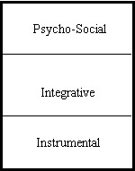
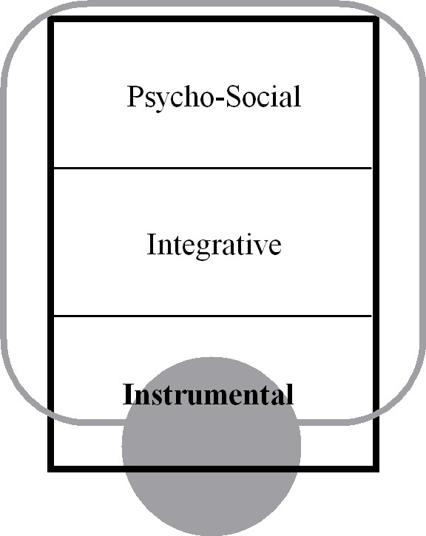
Intercultural Interaction Model
Acculturation Attitudes in SLA (Culhane, 2004)
Psycho-social: Core MNs are affected
Integrative: Peripheral MNs are affected
Instrumental: MNs are not involved
Marginalized
No L2/C2 MNs have formed
→ Leaving C2 may uncover acquired MNs.
L1/C1
L2/C2

Slide 28
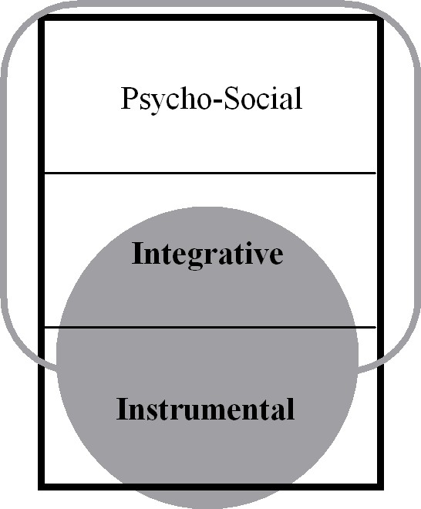
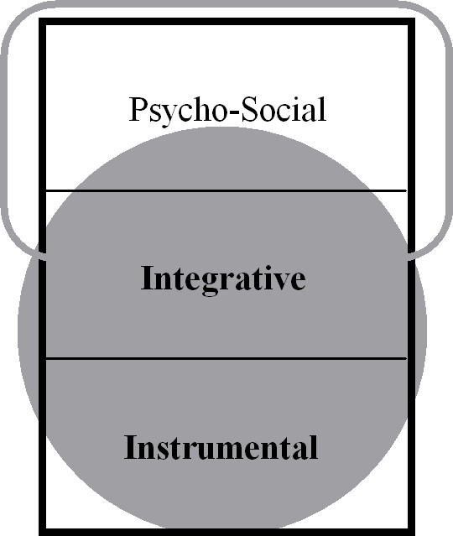
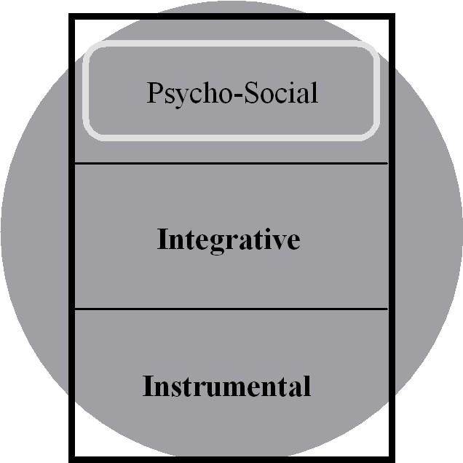
Separated
Peripheral MNs of L2/C2 acquired, but core MNs of L1/C1 drive behaviour.
→ Appears to be integrated because C1 is not public.
Integrated
Some core MNs of L2/C2 have been acquired.
→ Can lead to L1+L2 = C3, or third culture kids.
Assimilated
Only core MNs of L1/C1 remain.
→ Further assimilation will threaten core MNs and may trigger a backlash.

Slide 29
VIII. The Power of Mental Networks
MNs resist dissection
  Cross-cultural misunderstanding
  People react when others analyze their MNs (Kubota, 1999).
MNs can overwhelm thought
  Linguistics reinterpreted as power struggles (Norton, 1997).
  Cultural cliques take over classroom.
MNs can infect technical thought
  The MN lies hidden behind the technical thought
  Alternate viewpoints often ridiculed (Kuhn, 1962)

Slide 30
Brief Reflection
How have mental networks affected the learning process in your classroom?

Slide 31
IX. Societal Stages
Habermas
A Cognitive Examination of his first two stages
Habermas describes a mental shift involving Mercy and Perceiver
  Mercy thought remembers emotional experiences
  Perceiver thought looks for facts--which organize and connect Mercy experiences
1. Representative publicity (Mercy emotions overwhelm Perceiver thought)
  The emotional status of the leader is paramount—aura
  This emotional status overwhelms Perceiver thought
2. Bourgeois public sphere (Perceiver thought is functioning)
  Perceiver facts no longer accepted blindly; are independent of Mercy emotions in rule of law
  Perceiver facts connect Mercy experiences through travel and trade; organizes Mercy experiences with private property and personal identity
  Perceiver thought looks for facts in news; tests facts in debate and print

Slide 32
X. Cognitive Development
Male: Perry (1970)
Males ignore MNs to develop P.
Dualism: P is mesmerized by MNs
Multiplicity: P is not mesmerized but also not functioning
Procedural Knowledge: P is functioning
Constructed Knowledge: P applies increasingly to MNs
Female: Belenky (1986)
Females learn to manipulate MNs.
Silence: Other MNs suppress identity
Received Knowledge: Other MNs define identity
Subjective Knowledge: MNs define P ‘truth’
Procedural Knowledge: P evaluates MNs
Constructed Knowledge: P manipulates MNs

Slide 33
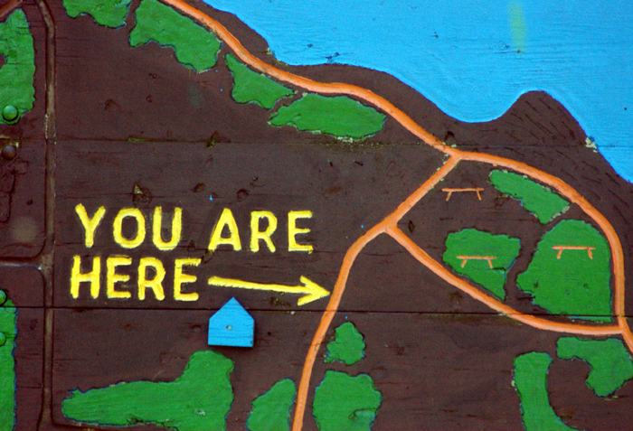
Concrete Thought
WHAT DOES IT MEAN TO BE AN INDIVIDUAL PERSON?
  Perceiver confidence is required to place personal identity within a map
  → Inescapable MNs define personal identity (You are here)
→ Mercy experiences provide the raw material
→ Perceiver facts arrange experiences into a map
Goals are emotional; emotions can overwhelm facts
  Contributor thought: Choices based in cause-and-effect
  Server thought: Actions guided by skills

Slide 34
XI. Possible Selves
Any MN is potentially a self
MNs that are always repeated are inescapable
  Defined by the physical body, knowledge, and skills
  The ‘actual self’ (Higgins, 1987); intrinsic motivation
  Perceiver confidence is required to recognize this inescapability
MNs with strong emotions feel inescapable—if triggered
  Defined by parents, culture, and authority figures
  The ‘ought self’ (Higgins, 1987); extrinsic motivation
  Many inconsistent MNs since Perceiver thought overwhelmed
  Triggered mainly by others when violated (Dornyei, 2009)
MNs can contain painful experiences (feared self)
Perceiver confidence increases ability to manipulate MNs
  Core MNs can only be changed by playing one against another

Slide 35
Two Kinds of Mental Networks
Two kinds of mental networks (Friesen, 2012, pp. 85-87)
  Emotional Mercy experiences can form MNs (MMN)
    Culture, people, situations, and even objects
  General Teacher theories can form MNs (TMN)
    A TMN demands to impose its explanation
    Paradigms have emotional power (Kuhn, 1962)
    Language and ‘international community’
    Self-motivated learning
    Implicature can be driven by common sense (TMNs)
Two kinds of ‘culture shock’
  Incompatible experiences threaten MMNs (anomie)
  Paradigm shifts threaten TMNs

Slide 36






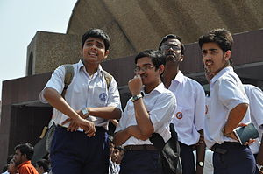
EFL → MMNs
Specific culture
Ethnic identity
Accent
EIL → TMNs
Intercultural
experience
International
community
Intelligibility
TMNs/MMNs
Don’t confuse
Separate general
from specific

Slide 37
Object Recognition vs. Meaning
TESOL studies linguistics and culture (Norton, 1997)
  MMNs can disable theorizing
TMN and MMN affect each other indirectly
  Perceiver thought combines object recognition and meaning
Object recognition affects meaning
  Learning precise meanings may question MMNs (Citron, 1995)
Meaning affects object recognition
  Paradigms alter seeing; incommensurability (Kuhn, 1962)
  Thinking and dreaming in French led to ‘anomie’ (Lambert, 1972)
Shaky MMNs help language learning
  Perceived social distance helps language acquisition (Acton, 1979)

Slide 38
XII. The ‘Ideal’ Possible Self
Question: What are the mechanisms behind Dornyei’s (2009) ideal self? What makes a possible self ideal, realizable, stable and intrinsic?
Ideal → a TMN makes identity simpler and more ideal
  Eg. the international businessman
Realizable → based in universal natural law and cognitive mechanisms
- A TMN makes these understandings inescapable.
Stable → present and future selves can co-exist within a structured process
  A TMN bridges present and future by changing identity from a picture to a movie
Intrinsic → A general understanding reassembles reality
  An internal reassembly sees the potential in situations rather than staying locked into one’s environment

Slide 39
The ‘Ideal’ Possible Self
The ideal self motivates the actual self
  The actual self is factual; ideal self is emotional
  Migration & mass media expand imagined communities (Kanno and Norton, 2003)
The actual self realizes the ideal self (Dornyei, 2009, p. 18)
  Use facts to apply ideal self to specific situation
Taking the steps on the previous slide transforms the ought self
  The actual self reassembles, the ideal self reassures.
  Dornyei (2009) cautions against violating the ought self.
  MSM aims to integrate the MMNs of the ought self.

Slide 40

XIII. Third Culture Kids
Fragmented MNNs (Pollock, 2009):
  Identity questions, personal issues, personal commitment
A TMN first causes then minimizes anomie
  A meta-theory like MSM can help in a more general way
A TMN can act as a ‘spacesuit’ to minimize feelings of anomie
  The skilled expat has a spacesuit, the immigrant doesn’t
  81% of TCKs earn at least Bachelor’s degrees vs. 21% (Cottrell & Unseem, 1993)
Actual self is modified—larger world view
  Adapt to different cultures
Ought self is transformed
  Enjoy crossing cultures, third culture kids

Slide 41
Summary - Key MSM Mechanisms
Cognitive styles emphasize different aspects of learning.
Cognitive modules function similarly in many different fields.
Technical thought is a more rigorous but limited version of normal thought.
The operation of mental networks form identity, culture and social interaction.
Teacher and Mercy thought generate two different types of emotion.
Factual processing must contend with emotional pressure.
The interplay between TMN and MMN makes personal transformation possible.

Slide 42
Some Applications
Include the language of MSM in your discussions
Problem 1: You are teaching Korean children for a week of ESL classes. How do you modify your expectations and approach?
Problem 2: You are teaching a news media and debate class to international students, half of which are mainland Chinese. How can cultural tensions be used facilitate learning EIL?
Problem 3: You are an administrator in a TESOL program. Some participants are questioning the efficacy of the program. How can a knowledge of MSM help you address the problem?

Slide 43
References
Acton, William (1979). Second language learning and perception of difference in attitude. Unpublished doctoral dissertation, University of Michigan.
Acton, William (1984). Changing fossilized pronunciation. TESOL Quarterly, 18(1), 71-85.
Arundale, Robert B. (1999). An alternative model and ideology of communication for an alternative to politeness theory. Pragmatics, 9(1), 119-153.
Arundale, Robert B. (2006). Face as relational and interactional: A communication framework for research on face, facework and politeness. Journal of Politeness Research, 2, 193-216.
Beer, Jennifer S. et al.(2003). The regulatory function of self-conscious emotion: Insights from patients with orbitofrontal damage. Journal of Personality and Social Psychology, 85(4), 594–604.
Belenky, M.F., Clinchy, B. M., Goldberger, N.R., Tarule, J.M. (1986). Women’s ways of knowing: The development of self voice and mind. New York: Basic Books Inc. http://collegestudentdeveltheory.blogspot.ca/2010/10/womens-ways-of-knowing-synopsis-by-e.html
Bloom, B.S. (1956). Taxonomy of educational objectives. Boston, MA: Allyn and Bacon.
Briggs, Farran and Usrey, Martin W. (2008) Emerging views of corticothalamic function. Current Opinions in Neurobiology, 18(4), 403–407. doi:10.1016/j.conb.2008.09.002.
Chan, Dennis et al. (2009). The clinical profile of right temporal lobe atrophy. BRAIN: a Journal of Neurology, 132, 1287-1298.
Chomsky, Noam. (1966). Topics in the Theory of Generative Grammar. The Hague, The Netherlands: Mouton and Co.
Cohen, Michael X. and Frank, Michael J. (2009). Neurocomputational models of basal ganglia function in learning, memory and choice. Behavioural Brain Research, 199(1), 141–156.
Cook, Vivian. Krashen’s Comprehension Hypothesis Model of L2 Learning. Retrieved from http://homepage.ntlworld.com/vivian.c/SLA/Krashen.htm

Slide 44
Cottrell, A.B. and Useem, R.H. (1993). TCKs four times more likely to earn bachelor's degrees. NewsLinks-The Newspaper of International Schools Services, 7(5), Princeton, NJ.
Culhane, S.F. (2004). An intercultural interaction model: Acculturation attitudes in second language acquisition. Electronic Journal of Foreign Language Teaching, 1(1). Retrieved from http://e-flt.nus.edu.sg/v1n12004/culhane.htm#3%20%20Acculturation%20attitudes
Damasio, Antonio. Descarte’s Error. (1994, 2006). USA: Penguin Books, getAbsract.
Damasio, Antonio. (1999). The Feeling of What Happens: Body and Emotion in the Making of Consciousness. London: Heinemann.
Davies, Bethan L. (2000). Grice’s Cooperative Principle: getting the meaning across. Leeds Working Papers in Linguistics, 8, 1-26.
Davies, Bethan L. (2007). Grice’s Cooperative Principle: Meaning and rationality. Journal of Pragmatics, 39, 2308-2331.
Davis, Wayne. (2007). Implicature: Intention, convention, and principle in the failure of Gricean theory.
Dörnyei, Zoltán. (2009). The L2 Motivational Self System. In Motivation, Language Identity and the L2 Self. Ed. Zoltán Dörnyei and Ema Ushioda. Bristol, UK: Multilingual Matters. 9-42.
Ellis, Nick C. (1998). Emergentism, connectionism and language learning. Language Learning 48(4), 631–664.
Friesen, Lane. (1986). Cognitive Styles in History: Perceiver and Mercy, first ed. Lane Friesen, Inc.
Friesen, Lane. (1986). Cognitive Styles in History: Contributor and Server, first ed. Lane Friesen, Inc.
Friesen, Lorin. (2012). God, Theology, and Cognitive Modules: A General Theory of Human Thought. Abbotsford, BC: Lorin Friesen.
Gardner, R.C. (2007). Motivation and Second Language Acquisition. University of Western Ontario. Porta Linguarum, 8, 9-20.

Slide 45
Greenberg, Joseph H. (1975). Research on Language Universals. Annual Review of Anthropology, 4, 75-94.
Grice, Paul. (1989). Studies in the Way of Words. Harvard, USA: Harvard UP. Chapter 2: Logic and Conversation.
Gregg, Kevin R. (2003) The state of emergentism in second language acquisition. Second Language Research, 19(2), 95-128.
Gregg, Kevin R. (2006). Taking a social turn for the worse: the language socialization paradigm for second language acquisition. Second Language Research 22(4), 413–442.
Habermas, Jürgen. (1991). The Structural Transformation of the Public Sphere: An Inquiry into the Category of Bourgeios Society. Cambridge, MA: MIT Press.
Hakansson, Gisela; Pienemann, Manfred; Sayelhi, Susan. (2002) Transfer and typological proximity in the context of second language processing. Second Language Research, 18(3), 250-273.
Higgins, Tory E. (1987). Self-discrepancy: A theory relating to self and affect. Psychological Review, 94(3), 319-340.
Jackendoff, Ray. (2002). Foundations of Language: Brain, Meaning, Grammar, Evolution. New York: Oxford UP.
Kanno, Yasuko and Norton, Bonny. (2003). Imagined communities and educational possibilities: Introduction. Journal of Language, Identity and Education, 2(4), 241-249.
Krashen, Stephen. (1982). Principles and Practice in Second Language Acquisition. University of Southern California.
Kubota, Ryoko. (1999). Japanese culture constructed by discourses: Implications for applied linguistics research and ELT. TESOL Quarterly, 43(1), 9-35.
Kuhn, Thomas S. (1962). The Structure of Scientific Revolutions. Chicago UP, 1962, 1970, 1996.
Lakoff, George and Johnson, Mark. (1980). The metaphorical structure of the human conceptual system. Cognitive Science, 4, 195-208.

Slide 46
Leudar, Ivan; Costall, Allan; Francis, Dave. (2004) Theory of mind: A critical assessment. Theory and Psychology, 14, 571.
Leslie, Alan M. (1987). Pretense and representation: The origins of “Theory of Mind”. Psychological Review, 94(4), 412-426.
Lightbown, Patsy M. and Spada, Nina. (2006). How Languages are Learned, 3rd ed. Oxford: Oxford UP.
Lindblom, Kenneth. (2001). Cooperating with Grice: A cross-disciplinary meta-perspective on uses of Grice’s cooperative principle. Journal of Pragmatics, 33, 1601-1623.
Nisbett, Richard E.; Choi, Incheol; Peng, Kaiping; Norenzaya, Ara. (2001). Culture and systems of thought: Holistic versus analytic cognition. Psychological Review, 108(2), 291-310.
Norton, Bonny. (1997). Language, identity and ownership of English. TESOL Quarterly, 31(3), 409-429.
Norton, Bonny. (2000) Identity and Language Learning: Identity, Gender Ethnicity and Educational Change. Language in Social Life Series. Ed. Christopher N. Candlin. Harlow, England: Longman Pearson Education.
Norton Pierce, Bonny. (1995). Social Identity, Investment and Language Learning. TESOL Quarterly, 29(1), 9-31.
Norenzaya, Ara and Heine, Steven J. (2005). Psychological universals: What are they and how can we know? Psychological Review ,131(5), 763-784.
Nuckolls, Janis B. (1993). The semantics of certainty in Quechua and its implications for a cultural epistemology. Language in Society, 22(2), 235-255.
O’Donnell et al. (2003). Creating intellectual capital: A Habermasian community of practice (CoP) Introduction. Journal of European Industrial Training, 27(2,3,4), 80-87.
Ortega, Lourdes. (2011). SLA after the social turn: Where cognitivism and its alternatives stand (ch. 7). In Dwight Atkinson (Ed.). Alternative Approaches to Second Language Acquisition. London and New York: Routledge.
Papafragou, Anna; Li, Peggy; Choi, Youngon; Han, Chung-hye. (2006). Evidentiality in language and cognition. Cognition, 103, 253-299

Slide 47
Perry, Bill. (1970). Forms of Intellectual and Ethical Development in the College Years: A Scheme. New York: Holt, Rinehart and Winston
Petitto, Laura-Ann and Dunbar, Kevin. (2004). New findings from Educational Neuroscience on Bilingual Brains, Scientific Brains, and the Educated Mind. MBE/Harvard, 1- 20
Piaget, J. (1926). The Language and Thought of the Child: Harcourt, Brace & Co.
Piaget, J. (1972). The Psychology of the Child. New York: Basic Books.
Pinker, Steven. (2007). The Language Instinct: How the Mind Creates Language. Chapter 8, The Tower of Babel. Penguin Books
Pollock, David C. and Van Reken, Ruth E. (2009). Third Culture Kids: Growing up Among Worlds. Rev. Ed. Boston, MA: Nicholas Brealey Publishing.
Rameson, Lian and Lieberman, Matthew D. (2007). Thinking about the self from a social cognitive neuroscience perspective. Los Angeles: University of California, Department of Psychology.
Rolls, Edmund T. and Grabenhorst, Fabian. (2008 ). The orbitofrontal cortex and beyond: From affect to decision-making. Progress in Neurobiology, 86, 216–244.
Scovel, Tom. (2001). Learning New Languages: A Guide to Second Language Learning. Boston: Heinle
Slobin, Dan I. (1973). Cognitive pre-requisites for the development of grammar. Studies of child language development. C. A. Ferguson and D.I. Slobin (Eds.). New York: Holt, Rinehart and Winston.
Sperber, Dan and Wilson, Deidre. (2002). Pragmatics, modularity and mind-reading. Mind and Language, 17, 3-23.
Stuss, Donald T. and Levine, Brian. (2002). Adult clinical neuropsychology: Lessons from studies of the frontal lobes. Annual Psychological Review, 53, 401–33.
Tocalli-Beller, Augustina and Swain, Merrill. (2005). Reformulation: The cognitive conflict and L2 learning it generates. International Journal of Applied Linguistics, 15(1), 5-28.
Ullman, Michael T. et al. Neurocomputational models of motor and cognitive deficits in Parkinson’s disease. Progress in Brain Research, 183, 275-297.

Slide 48
Thank you
for attending our
Cognitive Modeling for Critical Cross-Cultural Learning workshop!
Angelina Van Dyke
Lorin Friesen

